Slide 1

Sur quelques généralisations des divergences de Bregman
Frank Nielsen
Sony Computer Science Laboratories Inc
GdR IASIS
5 Juillet 2024

Slide 2

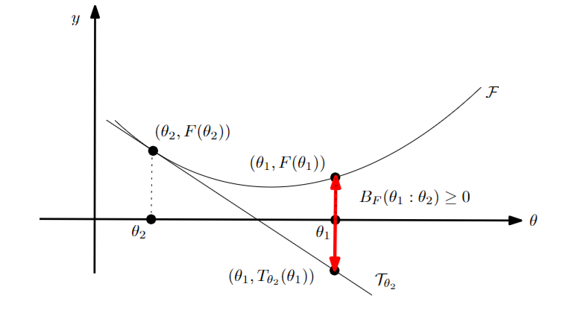



Bregman divergence (1960’s)
Let F: Θ⊆ℝ^{m}→ℝ be a strictly convex and smooth
real-valued function on a Hilbert space <.,.>
Bregman divergence B_{F}: Θ x Int(Θ) →ℝ
Lev M. Bregman
(1941 - 2023)
Photo: courtesy of
Alexander Fradkov
B_{F}(θ₁ : θ₂)=F(θ₁)-F(θ₂)-< θ₁ - θ_{2 ,} ∇F(θ₂) >
Popular in geometry, information theory, signal/sound processing!
Unify squared Euclidean divergence with Kullback-Leibler divergence F(θ)= Σ_{i} θ_{i} log(θ_{i}) and Itakura-Saito divergence F(θ)= Σ_{i} -log(θ_{i}).
The L22, KLD and ISD belong to a single family of β-divergences
Notes:
https://en.wikipedia.org/wiki/Mathematical_operators_and_
ℝ
symbols_in_Unicode
Θθ∇≻ξ∈
http://lib.physcon.ru/doc?id=5d34ad008433
Σ
Lev Meerovich Bregman
(1941 - 2023)

Slide 3
Bregman divergence: Taylor remainder
B_{F}(θ₁ : θ₂)=F(θ₁)-F(θ₂)-< θ₁ - θ_{2 ,} ∇F(θ₂) >
BDs are non-negative because = remainder of Taylor 1st order expansion:
F(θ₁)= F(θ₂)+< θ₁ - θ_{2 ,} ∇F(θ₂) >+ Remainder_{F}(θ₁ : θ₂)
BD = exact Lagrange remainder = a quadratic distance:
LagrangeRemainder_{F}(θ₁ : θ₂)= ½ (θ₁ - θ₂ )^{T} ∇²F(ξ) (θ₁ - θ₂ ) = B_{F}(θ₁ : θ₂)
for some ξ ∈ [θ₁ θ₂ ]
BDs are never metrics and
BDs are only symmetric for generalized quadratic distance (proof: ∇²F constant)
F_{Q}(θ)= ½ θ^{T} Q θ, where Q is symmetric positive-definite matrix
Q=I, squared Euclidean distance
Notes:
https://en.wikipedia.org/wiki/Mathematical_operators_and_
ℝ
symbols_in_Unicode
Θθ∇≻ξ∈
http://lib.physcon.ru/doc?id=5d34ad008433
Σ
Lev Meerovich Bregman
(1941 - 2023)

Slide 4

Bregman divergences in machine learning
Kullback-Leibler divergence between two probability densities:
D_{KL}[p(x):q(x)]= ∫ p(x) log (p(x)/q(x)) dμ(x)
difficult to calculate in closed form because of the integral ∫ …
But the Kullback-Leibler divergence between two probability densities of an exponential family like Gaussians, Poisson, Dirichlet, Gamma/Beta, Wishart
amount to a reverse Bregman divergence B_{F}*(θ₁ : θ₂):= B_{F}(θ₂ : θ₁)
D_{KL}[p(x|θ₁) : p(x|θ₂) ]=B_{F}*(θ₁ : θ₂)= B_{F}(θ₂ : θ₁) ⇒ Easy calculations
Notice divergence between parameters B_{F} vs divergence between functions KL
p(x| θ) ∝ exp(<x, θ >)
Bypass the ∫, ∇F easy!
Azoury, Katy S., and Manfred K. Warmuth. "Relative loss bounds for on-line density estimation with the exponential family of distributions." Machine learning 43 (2001)
Notes:
∫μ
∇F easy!
Information geometry proves that B_{F}(θ₁ : θ₂)= D_{KL}*[p(x|θ₁) : p(x|θ₂) ]
when F(θ)=log ∫ exp(<x, θ >) dμ(x) where D_{KL}*[p(x):q(x)]:= D_{KL}[q(x):p(x)] is the reverse Kullback-Leibler divergence

Slide 5
Convex duality via Legendre-Fenchel transform
Legendre-Fenchel transform of a convex function F:
F*(η)=sup _{θ ∈ ϴ} {< θ, η >-F(θ)}
Consider nice convex functions = Legendre-type functions (ϴ,F(θ)) :
(i) ϴ open, and (ii) lim _{θ→ ∂ϴ} ‖ ∇F (θ) ‖=∞
Then we get:
❶ reciprocal gradient maps η= ∇F (θ) and θ=∇F* (η), ∇F*=(∇F)⁻¹
❷ conjugation yields (H,F*(η)) of Legendre type
❸ biconjugation is an involution: (H,F*(η))*= (H*=ϴ,F**=F(θ))
Convex conjugate: F*(η)= < ∇F⁻¹ (η), η >-F(∇F⁻¹(η)) since η= ∇F (θ)
Notes:
η → ‖ ∞

Slide 6
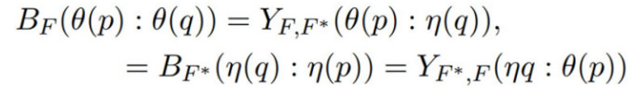
Fenchel-Young divergence: Mixed parameterization
Young inequality: F (θ₁)+F* (η₂)≥ < θ_{1 ,} η₂> with equality when η₂ = ∇F (θ₁)
Build the Fenchel-Young divergence from the inequality: lhs-rhs ≥0
Y_{F, F*}(θ_{1,} η₂)= F (θ₁)+F* (η₂)-< θ_{1 ,} η₂> ≥ 0
Two parameterizations θ and η : B_{F}(θ₁ : θ₂)= Y_{F, F*}(θ_{1,} η₂)
In general, 2^{n} equivalent equations with n variables
Amari, Shun-ichi. Differential-geometrical methods in statistics. Vol. 28. Springer, 1985
Notes:
Amari, Shun-ichi. Differential-geometrical methods in statistics. Vol. 28. Springer, 1985

Slide 7
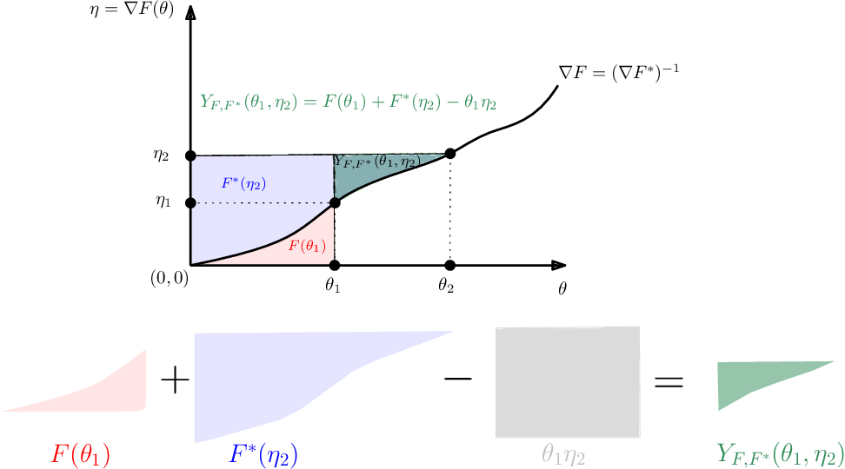
Visual interpretation of Fenchel-Young divergences
F strictly convex
F’’>0
F’ ↗ strictly increasing
Notes:
Very important: measures area

Slide 8
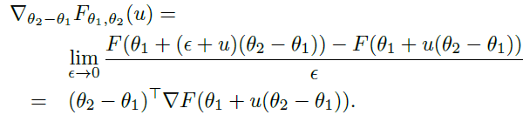
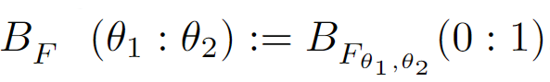
Multivariate Bregman divergence as families of univariate Bregman divergences
A d-variate function F(θ) can be equivalently handed as a family of 1D convex functions: {F_{θ1,θ2}(α)=F( (1- α)θ₁+ αθ₂ )}
A d-variate BD can be written as an equivalent 1D scalar BD:
Directional derivative
(F_{θ,θ})’(u)
Hence, write BD as equivalent scalar BDs:
write a BD wrt to anchor points as a sub-dimensional Bregman divergence
The chord gap divergence and a generalization of the Bhattacharyya distance." IEEE ICASSP, 2018
Notes:
Nielsen, Frank, and Richard Nock. "The Bregman chord divergence." Geometric Science of Information: 4th International Conference, GSI 2019, Toulouse, France, August 27–29, 2019, Proceedings 4. Springer International Publishing, 2019.
Nielsen, Frank. "The chord gap divergence and a generalization of the Bhattacharyya distance." 2018 IEEE International Conference on Acoustics, Speech and Signal Processing (ICASSP). IEEE, 2018.

Slide 9

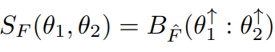
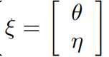
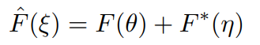
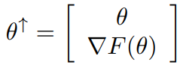
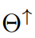
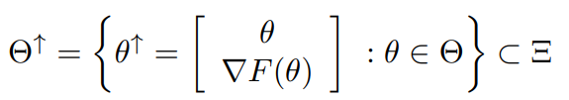
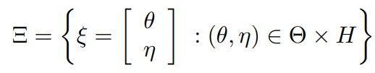
Symmetrized Bregman divergences are not Bregman divergences except for quadratic distances
Symmetrized Bregman divergence:
We may double the dimension, and write:
parameter space is not convex in general !
Except for generalized quadratic distances (Mahalanobis), SBDs are not BDs. SBDs are curved Bregman divergences. Update B_{F}: θx Int(θ) to θx RelInt(θ)
Bregman divergence restricted to a linear subspace is sub-dimensional Bregman divergence : For example, extended KLD vs KLD on simplexΔ
N+Nock., Sided and symmetrized Bregman centroids." IEEE transactions on Information Theory (2009)
Notes:
N+Nock., Sided and symmetrized Bregman centroids." IEEE transactions on Information Theory (2009)

Slide 10
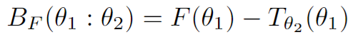
How can we measure other convexity gaps in graphs?
B_{F}(θ₁ : θ₂) = F(θ₁) - (F(θ₂)+< θ₁ - θ_{2 ,} ∇F(θ₂) >)
Bregman divergence
as a vertical convex gap
Function evaluated at θ₁
?
vertical convex gap
Generalize BDs by measuring
various convex gaps?
Tangent line at θ₂ evaluated at θ₁
Univariate: B_{F}(θ₁ : θ₂)=F(θ₁)-F(θ₂)-(θ₁ - θ₂) F’(θ₂)
Notes:
Σ
Nielsen, Frank, and Richard Nock. "The Bregman chord divergence." Geometric Science of Information: 4th International Conference, GSI 2019, Toulouse, France, August 27–29, 2019, Proceedings 4. Springer International Publishing, 2019.

Slide 11
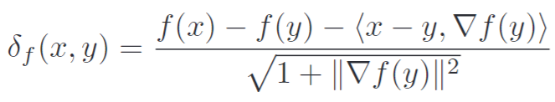
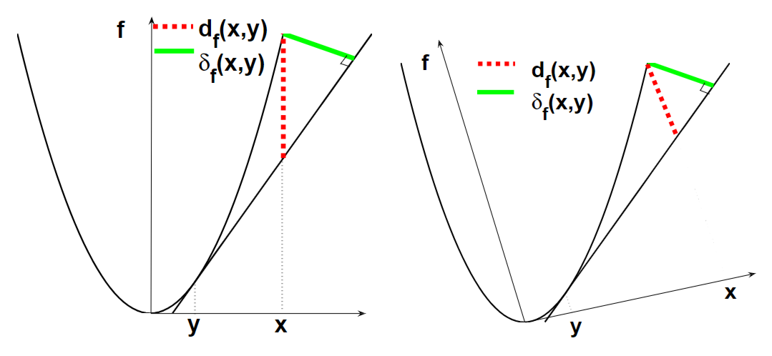
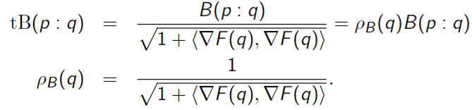
Total Bregman divergences
Invariant to rotation
Robust clustering with respect outliers
Conformal Bregman divergence
Total Bregman Divergence and its Applications to Shape Retrieval, 2010

Slide 12
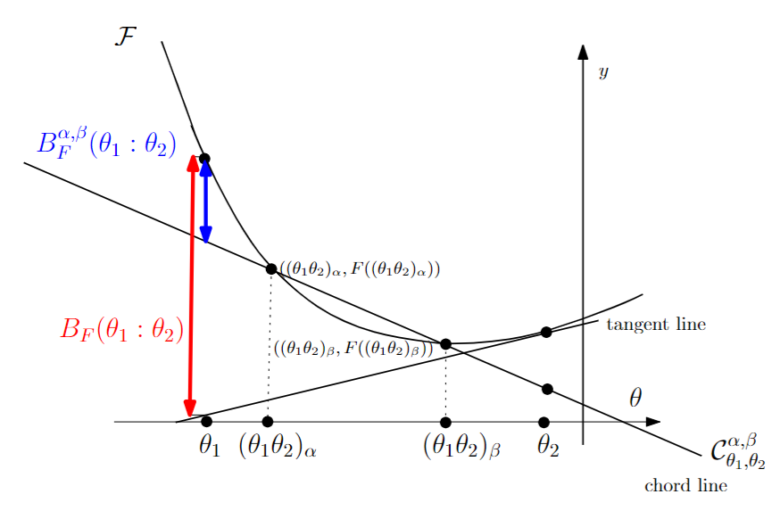
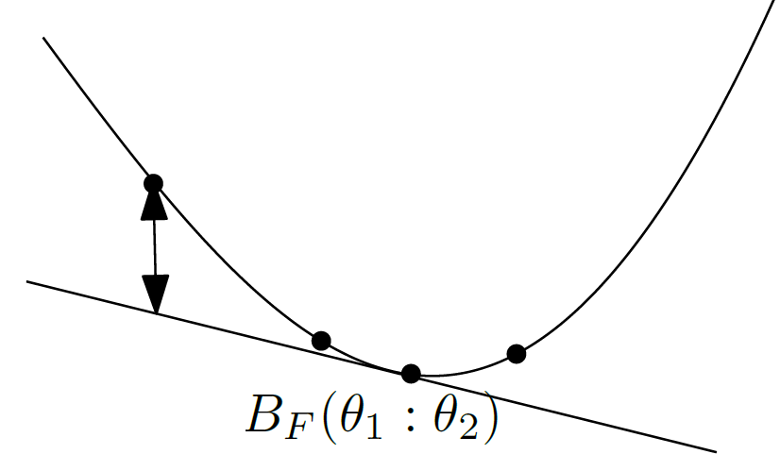
Bregman-type divergences measuring convexity gaps
α → β
No gradient ∇F required!
α
When α → β, Bregman chord divergences → Bregman tangent divergences
or Bregman secant divergences
The Bregman chord divergence, 1810.09113
Notes:
When α → β, Bregman chord divergences → Bregman tangent divergences

Slide 13
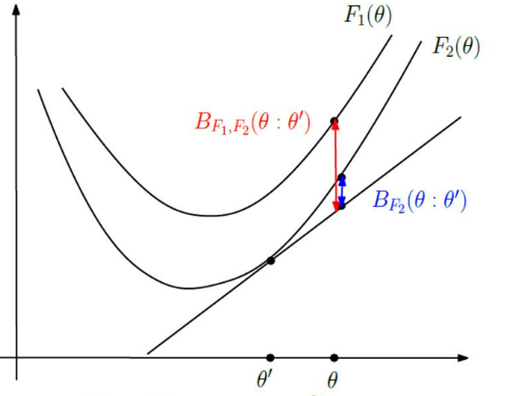

Duo Bregman divergences: Generalize BDs with a pair of generators
One generator majorizes the other one:
F₁(θ) ≥ F₂(θ)
Then
B_{F1,F2}(θ’’:θ’’)
≥ B_{F}(θ: θ’)
θ’’
Recover Bregman divergence when F₁(θ) = F₂(θ) = F(θ)
Only pseudo-divergence because B_{F1,F2}(θ’’: θ’’) may be positive, not zero
B_{F}(θ₁ : θ₂)=F(θ₁)-F(θ₂)-< θ₁ - θ_{2 ,} ∇F(θ₂)>
Notes:
≥ B_{F}(θ: θ’)

Slide 14
KLD between nested exponential families amount to duo Bregman divergences
q(x| θ)» p(x| θ)
p(x| θ)
X₁
X₂
q(x| θ)
Consider an exponential family on support X₁:
p(x| θ) = exp(<x, θ >-F₁(θ)) dμ(x)
with cumulant function F₁(θ)=log ∫_{X1} exp(<x, θ >) dμ(x)
Another exponential family with nested supports: X₁ ⊆ X₂
q(x| θ) = exp(<x, θ >-F₂(θ)) dμ(x)
is an exponential family with F₂(θ)=log ∫_{X2} exp(<x, θ >) dμ(x) ≥ F₁(θ)
Then KLD amounts to a reverse duo Bregman pseudo-divergence:
D_{KL}[p(x| θ₁) : q(x| θ₂) ]= B_{F2F1}*(θ_{1:} θ₂)=B_{F2F1}(θ₂: θ₁)
D_{KL}[p(x):q(x)]= ∫ p(x) log (p(x)/q(x)) dμ(x)
0 log(0/0)=0
"Statistical divergences between densities of truncated exponential families with nested supports: Duo Bregman and duo Jensen divergences." Entropy 24.3 (2022)
Notes:
»
Nielsen, Frank. "Statistical divergences between densities of truncated exponential families with nested supports: Duo Bregman and duo Jensen divergences." Entropy 24.3 (2022): 421.

Slide 15
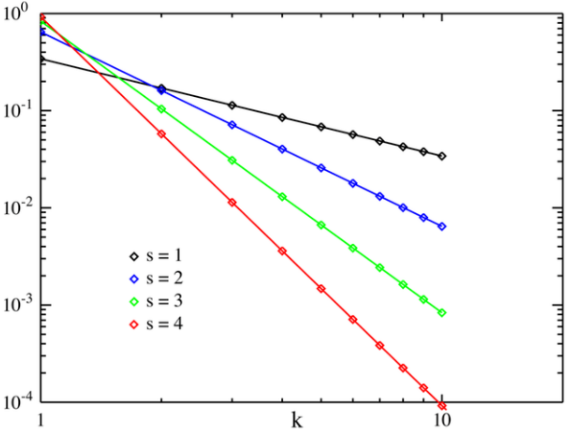
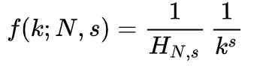
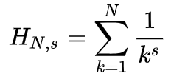
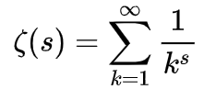
Application of duo Bregman divergences: Clustering distributions with different supports
Consider n truncated densities p(x| θ _{i}) = exp(<x, θ _{i} >-F_{i}(θ _{i})) dμ(x) with potentially different supports X_{i} ⊆ X : e.g., Zipf’s distributions
Cluster those distributions using full support X prototypes: e.g., Zeta distributions
Objective is a la “k-means”: minimize Σ_{i} D_{KL}[p(x|θ_{i}) : {q(x|λ_{j}) : j in {1,…,k} } ]
Duo Bregman k-means algorithm as an extension of Bregman k-means
Example: Cluster Zipf’s distributions from word frequencies in a collection of translations of a renown book. Find similarities of word frequency in languages
This ensures that q(x| λ_{j})» p(x| θ_{i})
MaxEnt’22, arXiv:2104.10548
Notes:
Nielsen, Frank. "A note on some information-theoretic divergences between Zeta distributions." arXiv preprint arXiv:2104.10548 (2021).

Slide 16
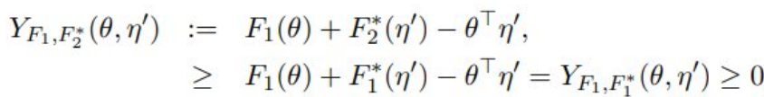
Solo and duo Fenchel-Young divergences
Young inequality: F (θ₁)+F* (η₂)≥ < θ_{1 ,} η₂> with equality when η₂ = ∇F (θ₁)
Build the Fenchel-Young divergence from the inequality: lhs-rhs ≥0
Y_{F, F*}(θ_{1,} η₂)= F (θ₁)+F* (η₂)-< θ_{1 ,} η₂> ≥0
Legendre transform reverses majorization order:
F₁(θ) ≥ F₂(θ) ⇔ F₁^{*(}η) ≤ F₂*(η)
Duo Fenchel-Young divergence:
Amari, Shun-ichi. Differential-geometrical methods in statistics. Vol. 28. Springer, 1985
Notes:
Amari, Shun-ichi. Differential-geometrical methods in statistics. Vol. 28. Springer, 1985

Slide 17
Biduality reference/representation
Legendre-Fenchel transformation * induces two functions:
❶ a convex conjugate function F*(.) : η →F*(η)
❷ a gradient map: η= ∇F (.): θ → η(θ)= ∇F (θ)
This yields the interplay of two dualities:
❶ Reference duality of divergences: D*(p₁:p₂):=D(p_{2:} p₁), (D*)*=D
❷ Representation duality: θ*=∇F (θ), and (θ*)*= θ
Fenchel-Young divergence demonstrates the biduality interaction:
(Y_{F})*(θ₁:θ₂*) = Y_{F}(θ₂*: θ₁) = Y_{F*}(θ₂*: θ₁)
Functional divergences on densities as pointwise scalar BD can
use monotone (ρ, τ)-embedding dualities
Brekelmans+, Variational representations of annealing paths: Bregman information under monotonic embedding, Information Geometry (2024)
Notes:
$$
({Y_F})^\repduality(\theta_1,\theta_2^\refduality) = {Y_F^\convexduality}(\theta_2^\refduality,\theta_1)
$$
ρ, τ
https://link.springer.com/article/10.1007/s41884-023-00129-6
Brekelmans+N, Variational representations of annealing paths: Bregman information under monotonic embedding, Information Geometry (2024)

Slide 18
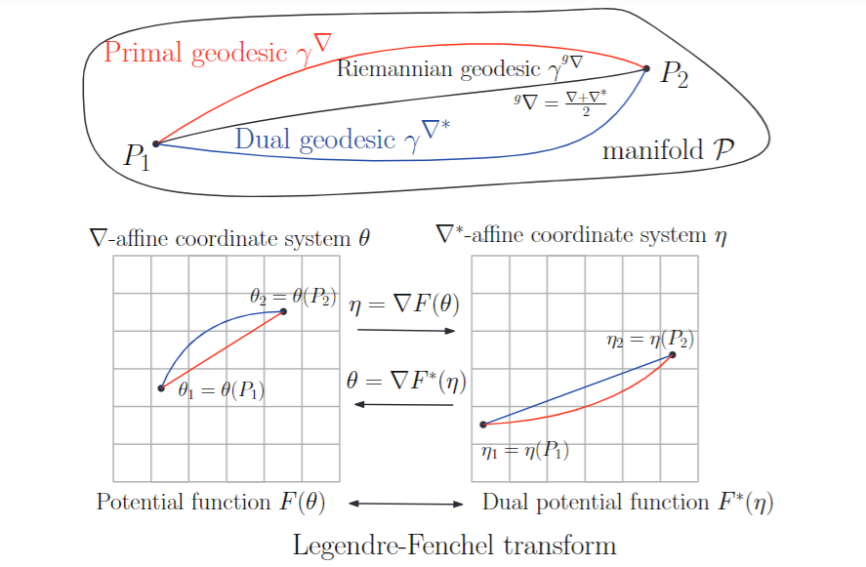
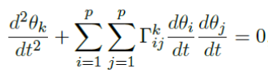
Bregman manifolds:
Convex conjugates (F, F*) yield dual flat connections
(M,F →g(θ)= ∇²F(θ), F → ∇ , F* → ∇*)
A connection ∇ is flat if there exists a coordinate systemθ such that all Christoffel symbols vanish: Γ (θ) =0.
θ is called ∇ –affine coordinate system
∇-geodesic solves as line segments
"The many faces of information geometry." Not. Am. Math. Soc 69.1 (2022): 36-45.
Notes:
Nielsen, Frank. "The many faces of information geometry." Not. Am. Math. Soc 69.1 (2022): 36-45.

Slide 19
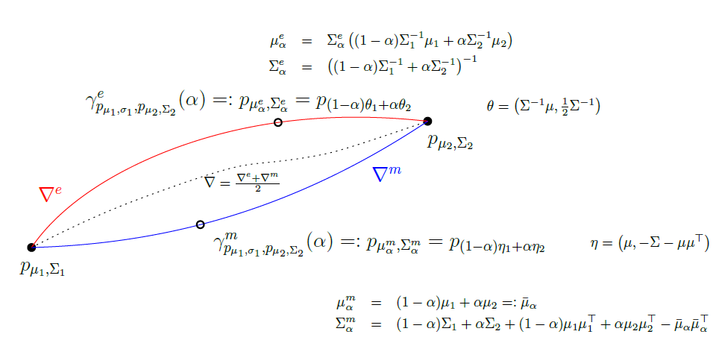
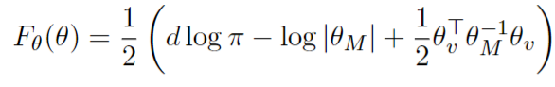
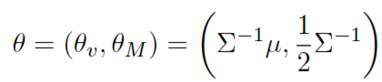

Example: Bregman manifold of multivariate normals
Cumulant function, convex:
Natural parameters:
e-geodesic
Fisher-Rao geodesic
m-geodesic (beware: not mixture of Gaussians)
Kullback-Leibler divergence = reverse Bregman div
(M,g, ∇ , ∇*)
Geometric Jensen-Shannon divergence, 2019

Slide 20

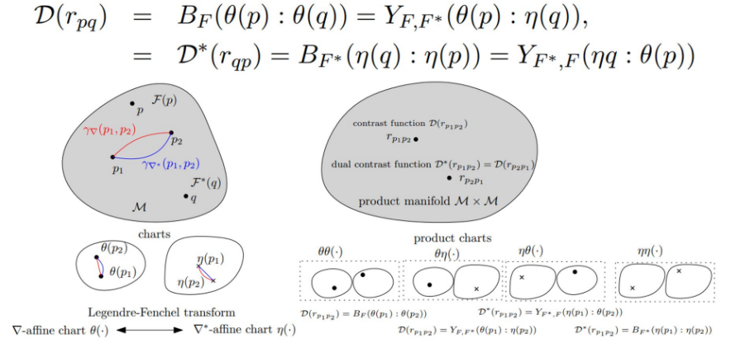
Bregman manifolds and contrast functions
A strictly convex and smooth Legendre-type function induces a dually flat space also called a global Hessian manifold in diff. geo.
Dually flat divergence
Product manifold
view
Divergence =
Contrast function on product manifold
Reciprocally, a dually flat space induces a class of equivalent pair of Legendre-type functions with dual Bregman/Fenchel-Young divergences. Bregman divergences = canonical divergences of dually flat spaces

Slide 21
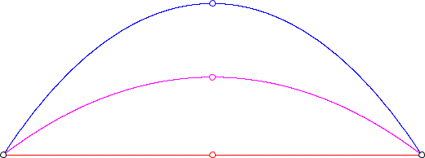
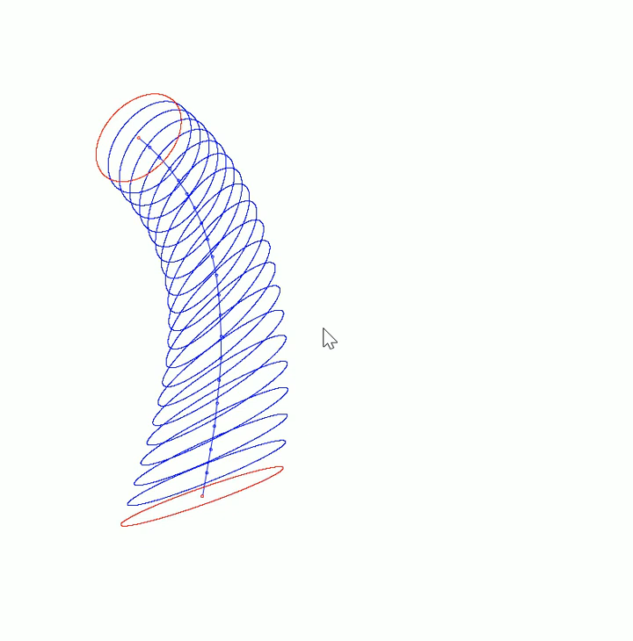
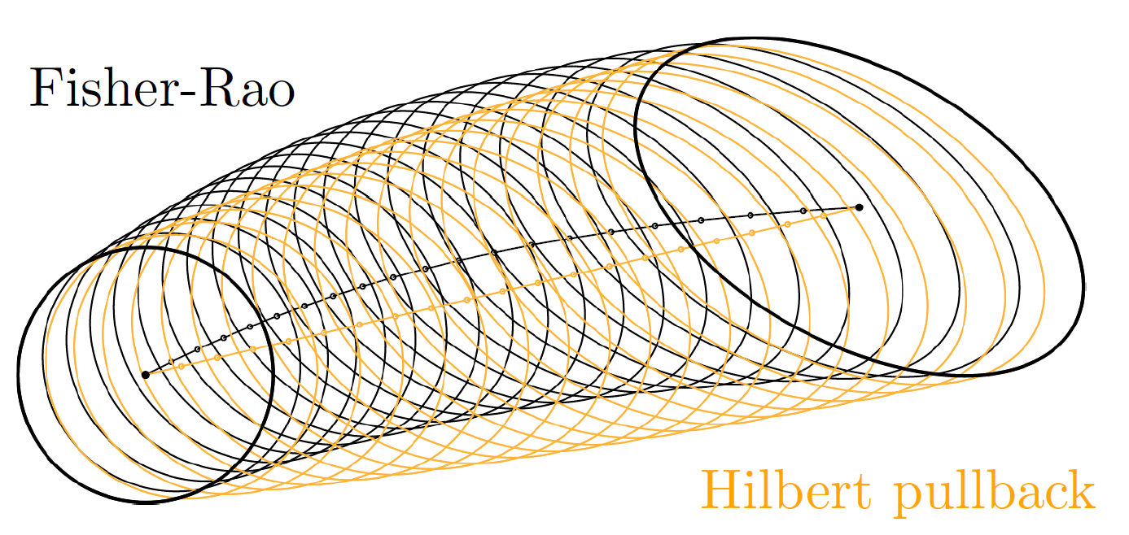
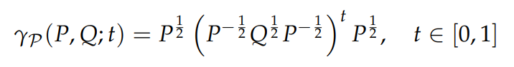
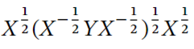
Fisher-Rao geodesics for d-variate normals
When d>1, some sectional curvatures of (M,g_{Fisher}) are positive,
Fisher-Rao is not Hadamard manifold.
But centered normal submanifold is Hadamard
∇*-geodesic (m-geodesic)
∇^{g}-geodesic (length minimizing geodesic)
∇-geodesic (e-geodesic)
Embed in SPD
of dimension
2d+1, submersion
Geodesic in closed form same-mean centered normal:
t=1/2 yields matrix geometric mean G(X,Y)=
Kobayashi, Geodesics of multivariate normal distributions and a Toda lattice type Lax pair, Physica Scripta 98.11 (2023)
Fisher-Rao and pullback Hilbert cone distances on the multivariate Gaussian manifold with applications to simplification and quantization of mixtures, ICML TAG 2023.

Slide 22
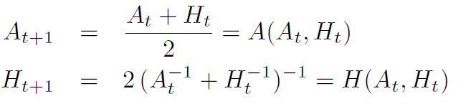
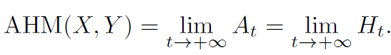

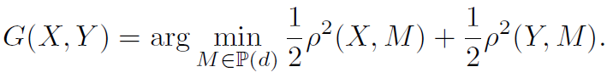
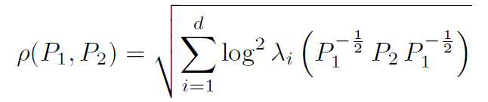
Inductive matrix arithmetic-harmonic mean (AHM)
Consider the cone of symmetric positive-definite matrices (SPD cone), and extend the AHM to SPD matrices:
Sequence with A₀=X and H₀=Y converge quadratically to matrix geometric mean:
[Nakamura 2001]
←arithmetic mean
←harmonic mean
which is also the Riemannian center of mass wrt the trace metric:
Riemannian distance
What is… an Inductive Mean? Notices of the American Mathematical Society 2023
Notes:
What is… an Inductive Mean? Notices of the American Mathematical Society 2023

Slide 23
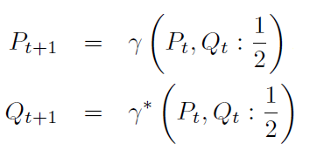
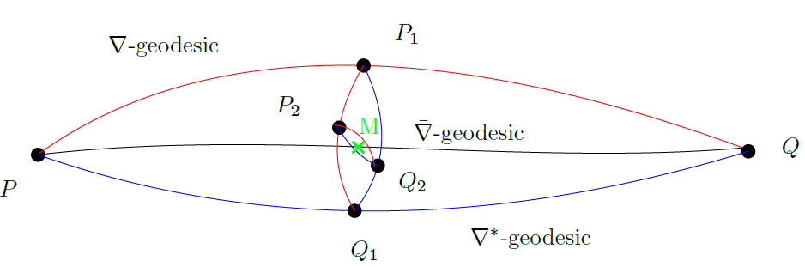
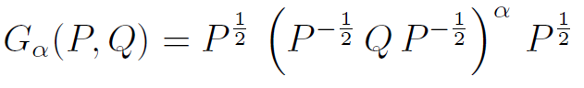
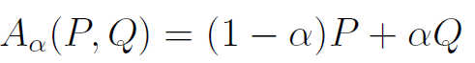
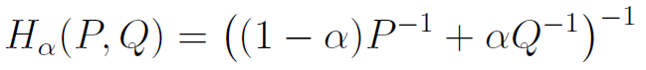
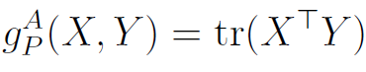
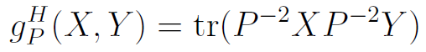
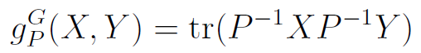
Geometric interpretation of the AHM matrix mean
Repeat:
(SPD, g^{G}, ∇^{A}, ∇^{H}) is a dually flat space, ∇^{G} is Levi-Civita connection
Dually flat space (SPD, g^{G}, ∇^{A}, ∇^{H})
Primal geodesic midpoint is the arithmetic center wrt Euclidean metric
Dual geodesic midpoint = harmonic center wrt an isometric Eucl. metric
Levi-Civita geodesic midpoint is geometric Karcher mean
Here, all 3 connections are metric connections
[Nakamura 2001]

Slide 24
Bregman manifolds and Bregman divergences
Any Legendre-type function (ϴ,F(θ)) generates DFS (M,g, ∇ , ∇*) where F(θ) defines flat connection ∇ via Christoffel symbols Γ (θ) =0, and F* (η) defines flat connection ∇* via Christoffel symbols Γ* (η)=0
Duality in information geometry: (∇ + ∇*)/2 is Levi-Civita connection ∇^{g}
For example:
The cumulant functions of exponential families
F(θ)=log ∫ exp(<x, θ >) dμ(x). In that case, the Bregman divergence amounts to a reverse Kullback-Leibler divergence
The partition functions Z(θ)=∫ exp(<x, θ >) dμ(x)=exp(F(θ)) is log-convex and log-convex functions are convex. Hence, we can build a Bregman manifold from Z(θ) too!
Question: What is the reconstructed statistical divergence from Bregman divergence B_{Z}?
"Divergences Induced by the Cumulant and Partition Functions of Exponential Families
and Their Deformations Induced by Comparative Convexity." Entropy 26.3 (2024)
Notes:
Nielsen, Frank. "An elementary introduction to information geometry." Entropy 22.10 (2020): 1100.

Slide 25
Kullback-Leibler divergence between non-normalized exponential family densities
Kullback-Leibler divergence between two positive measures:
D_{KL}⁺[p₁(x):p₂(x)] = ∫ { p₁(x) log (p₁(x)/p₂(x))+ p₂(x)-p₁(x) } dμ(x)
Exponential family density:
Normalized: p(x| θ) = exp(<x, θ >-F(θ)) dμ(x)
Non-normalized: q(x| θ) = exp(<x, θ >) dμ(x)
Hence, p(x| θ)= q(x| θ)/Z(θ) with partition function Z(θ)=exp(F(θ)) and cumulant function F(θ)=log Z(θ)
F is convex and Z is log-convex, and log-convex functions are convex functions.
KLD between normalized densities = reverse Bregman wrt F:
D_{KL}[p_{θ1}(x):p_{θ2}(x)] = B_{F}*[θ₁: θ₂] = B_{F}[θ₂: θ₁]
KLD between non-normalized densities = reverse Bregman wrt Z:
D_{KL}⁺[p_{θ1}(x):p_{θ2}(x)] = B_{Z}*[θ₁: θ₂] = B_{Z}[θ₂: θ₁]
2312.12849

Slide 26
Proof: KLD non-normalized EFs = BD wrt Z
D_{KL}⁺[q_{θ1}(x):q_{θ2}(x)]=∫ { q _{θ1}(x) log (q _{θ1}(x)/q _{θ2}(x))+ q_{θ2}(x)-q_{θ1}(x) } dμ(x)
= Z(θ₂)-Z(θ₁)+ E_{qθ1}[<(θ₁- θ₂),x>]
Remember “moment parameter”: E_{pθ}[x]= η = ∇F(θ₁)
But E_{qθ1}[x] = Z(θ₁) E_{pθ1}[x] = Z(θ₁) η₁ = Z(θ₁) ∇F(θ₁)
Since F(θ) =log Z(θ) , we have ∇F(θ)=∇Z(θ)/Z(θ)
Hence, E_{qθ1}[x] = Z(θ₁) ∇F(θ₁) = Z(θ₁) ∇Z(θ₁)/Z(θ₁)=∇Z(θ₁)
D_{KL}⁺[q_{θ1}(x):q_{θ2}(x)]= Z(θ₂)-Z(θ₁)- < θ₂ ₋ θ_{1,}∇Z(θ₁)> = B_{Z}(θ₂: θ₁)

Slide 27
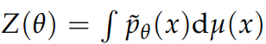
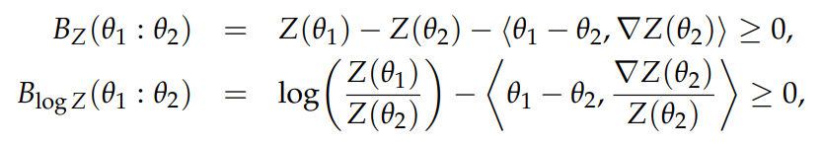
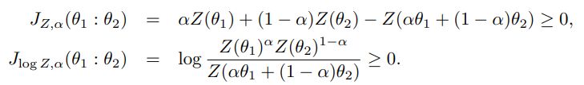

Bregman divergences and Jensen divergences Cumulant functions/Partition functions
F(θ)=log Z(θ) ↔ Z(θ)=exp(F(θ))
①
②
And furthermore, we can define skewed Jensen divergences from the convex generators:
①
②
Including the symmetric Jensen divergence when 𝛼=1/2:
Notes:
We can reconstruct statistical divergences from those BDs:
① ② ③

Slide 28

KLD/α-Bhattacharyya ⇔ Bregman/Jensen divergences when considering exponential families, F cumulant function
Jensen divergence
Approximate BD with JD forα=ε≅0
Bregman divergence
Question: What are the reconstructed statistical divergences from Jensen-Bregman divergence J_{Z} / B_{Z}?
Z: partition function
Zhang, Divergence function, duality, and convex analysis, Neural computation 16.1 (2004)
N + Boltz. "The Burbea-Rao and Bhattacharyya centroids." IEEE Transactions on Information Theory (2011)
Notes:
Zhang, Divergence function, duality, and convex analysis, Neural computation 16.1 (2004)
N and Boltz. "The burbea-rao and bhattacharyya centroids." IEEE Transactions on Information Theory 57.8 (2011)
α=ε≅0

Slide 29



Bregman divergences corresponding to partition functions
Question: What is the reconstructed statistical divergence from Bregman divergence B_{Z}?
Scaled skewed Jensen divergence
for partition function Z
Amari α-divergences extended to
positive measures
So B_{Z} corresponds to the reverse extended Kullback-Leibler divergence:
"Divergences Induced by the Cumulant and Partition Functions of Exponential Families
and Their Deformations Induced by Comparative Convexity." Entropy 26.3 (2024)
Notes:
Nielsen, Frank.

Slide 30






Information geometry in action! (1/2)
Set of categorical distributions form a mixture family M, a Bregman manifold for the negentropy generator
Given a set of n discrete distributions (categorical distributions, normalized histograms), calculate its Jensen-Shannon centroid
A mixture family is closed
under mixture operations
On a generalization of the Jensen–Shannon divergence and the Jensen–Shannon centroid, Entropy 22.2 (2020)
Notes:
Nielsen, Frank. "On a generalization of the Jensen–Shannon divergence and the Jensen–Shannon centroid." Entropy 22.2 (2020): 221.

Slide 31



Dual geodesics and Fisher-Rao geodesics on the categorical manifold
Δ₁
θ
Exponential ∇-geodesic
Mixture ∇*-geodesic
Fisher-Rao ∇^{g}-geodesic (Levi-Civita )

Slide 32



Geodesics coincide when passing
through a simplex vertex but not
the midpoints
Exponential ∇-geodesic
Mixture ∇*-geodesic
Fisher-Rao ∇^{g}-geodesic
(Levi-Civita )

Slide 33



Monte Carlo Bregman divergences
In some cases, integral Bregman generators are not available in closed-form or computationally intractable. Examples:
F(θ)=log ∫ exp(<Polynomial(x), θ >) dμ(x) or F(θ)=log Σ exp(<x, θ >)
By MC importance sampling on the integral, get with high probability a convex function approximating the generator. Perform algorithms on this randomized Bregman manifolds to get consistent algorithms.
Stochastic Bregman generator
Monte Carlo information-geometric structures
Geometric Structures of Information (2019): 69-103.
Notes:
Nielsen, Frank, and Gaëtan Hadjeres. "Monte Carlo information-geometric structures." Geometric Structures of Information (2019): 69-103.

Slide 34


Jensen-Shannon centroid for mixtures
Jensen-Shannon divergence between two mixtures amounts to a Jensen divergence:
Task: Given a set of discrete distributions (categorical distributions, normalized histograms), calculate its Jensen-Shannon centroid:
Need to minimize a difference of convex functions
DCA or ConCave Convex algorithm!

Slide 35


Jensen-Bregman divergence
Jensen-Bregman divergence is Jensen-Shannon symmetrization of Bregman divergence:
amounts to a Jensen divergence (also called Burbea-Rao divergence).
Jensen-Shannon centroid of a mixture family = Jensen-Bregman centroid = Jensen centroid
Skew Jensen-Bregman Voronoi diagrams." Transactions Voronoi Diagrams and Delaunay Triangulation (2011)
On the Jensen–Shannon symmetrization of distances relying on abstract means. Entropy 21.5 (2019)
Notes:
Nielsen, Frank, and Richard Nock. "Skew jensen-bregman voronoi diagrams." Transactions on Computational Science XIV: Special Issue on Voronoi Diagrams and Delaunay Triangulation (2011): 102-128.
Nielsen, Frank. "On the Jensen–Shannon symmetrization of distances relying on abstract means." Entropy 21.5 (2019): 485.

Slide 36


Jensen–Shannon centroid
Jeffreys SKL centroid
Jensen–Shannon centroid
do not require same support

Slide 37





Comparative convexity: (M,N)-convexity
Ordinary convexity of a function:
for all t in [0,1]
Definition: A function Z is (M,N)-convex iff for in α in [0,1]:
Ordinary convexity = (A,A)-convexity wrt to arithmetic weighted mean
Log-convexity: (A,G)-convexity wrt to A/geometric weighted means:
for all t in [0,1]
for all t in [0,1]

Slide 38






Comparative convexity wrt quasi-arithmetic means
quasi-arithmetic mean for a strictly monotone generator h(u):
Includes power means which are homogeneous means:
Include the geometric mean in the limit case p→0

Slide 39


Generalizing Bregman divergences with (M,N)-convexity: (M,N)-Bregman divergences
Skew Jensen divergence from (M,N) comparative convexity:
Non-negative for (M,N)-convex generators F, provided regular means M and N (e.g. power means)
Definition:
By analogy to limit of skewed Jensen divergences amount to
forward/reverse Bregman divergences.

Slide 40



Generalizing Bregman divergences with quasi-arithmetic mean convexity
Amounts to a conformal Bregman divergence on monotonic representations:
With generator:
Conformal factor
Remark: Conformal Bregman divergences may yield robustness in applications
Shape retrieval using hierarchical total Bregman soft clustering, IEEE Transactions on pattern analysis and machine intelligence (2012)

Slide 41
(M,N)-convexity for convex-preserving deformations
Recall that for exponential families, we had two convex functions:
We may thus deform F with (ρ, τ)-quasi-arithmetic means and seek the (ρ, τ)-convex function which also remains ordinary convex
For those convex-preserving (ρ, τ)-deformations, we get new Bregman divergences and Bregman manifolds to play with!
Convex F(θ)=log Z(θ) ↔ Log-convex Z(θ)=exp(F(θ)), hence convex
Cumulant function ↔ Partition function

Slide 42




A Python library for geometric computing on Bregman Manifolds
pyBregMan
https://franknielsen.github.io/pyBregMan/
Chernoff point
Jensen-Shannon centroid
Inductive AHM mean
Geometric matrix mean
Bregman/Jensen centroids
Joint work of Frank Nielsen and Alexander Soen

Slide 43
Some generalizations of Bregman divergences in this talk
Dually flat divergence & contrast function
(M,N)-Jensen divergence
(A,A)
(M,N)-Bregman
divergence
No ∇F
Skew scaled Jensen/Burbea-Rao divergence
≡
≅ forα → 0
=
(ρ, τ)
(A,A)
JS-symmetrization
Jensen-Bregman divergence
Bregman divergence
Conformal
Bregman divergence
Bregman-Chernoff divergence
≅
No ∇F
total Bregman div.
Duo Bregman pseudo-divergence
Bregman chord divergence
=
Bregman tangent divergence
Duo Fenchel-Young pseudo-divergence
But also matrix Bregman divergence, functional Bregman divergence, etc.

Slide 44


Thank you!
Many thanks to all my inspiring collaborators.
Special thanks to Richard Nock, Ke Sun, Ehsan Amid, and Alexander Soen
https://link.springer.com/journal/41884
https://franknielsen.github.io/

Slide 45





Information geometry in action! (2/2)
The Chernoff information between two distributions is defined by
Chernoff information is the maximal skew Bhattacharrya distance (not metric!):
α-Bhattacharrya distances related to Rényi α-divergences:
CI is often used in Bayesian hypothesis testing & information fusion
An information-geometric characterization of Chernoff information, IEEE Signal Processing Letters (2013)
Revisiting Chernoff information with likelihood ratio exponential families, Entropy 24.10 (2022)
Julier, An empirical study into the use of Chernoff information for robust, distributed fusion
of Gaussian mixture models , IEEE Information Fusion 2006.
Notes:
Nielsen, Frank. "Revisiting Chernoff information with likelihood ratio exponential families." Entropy 24.10 (2022): 1400.
Nielsen, Frank. "An information-geometric characterization of Chernoff information." IEEE Signal Processing Letters 20.3 (2013): 269-272.
Julier, An empirical study into the use of Chernoff information for robust, distributed fusion of Gaussian mixture models , IEEE Information Fusion 2006.

Slide 46

Generalized
to
exponential family
manifold
Example:
Gaussian manifold
p(x| θ) ∝ exp(<x, θ >)

Slide 47






Chernoff-Bregman divergence
Chernoff information:
Chernoff-Bregman is another way to symmetrize a Bregman divergence by maximizing the skew Jensen divergence:
This amounts to
Chernoff-Bregman divergence is the radius of a right-sided Bregman ball of two points
Chernoff point r*
(eKLD)
Exact smallest enclosing
Bregman ball of n points
Fitting the smallest enclosing Bregman ball, ECML’05
Notes:
Nock, Richard, and Frank Nielsen. "Fitting the smallest enclosing Bregman ball." European Conference on Machine Learning. Berlin, Heidelberg: Springer Berlin Heidelberg, 2005.

Slide 48

Categorical distributions: Both an exponential and a mixture family!
*
Dual of categorical exponential family is categorical mixture family,
and vice verse

Slide 49



Revisiting Chernoff information/Point
Consider p and q arbitrary probability densities:
Geometric mixture arc

Slide 50





Geometric mixture arc is a 1D likelihood ratio exponential family
Geometric mixture Bhattacharyya / exponential arc )
between two densities p, q of Lebesgue Banach space L₁(μ)
Set of geometric mixtures:
with normalization factor:
geometric mixture interpreted as a 1D exponential family: LREF
Natural parameter space:
k(x)=log q(x)
-

Slide 51



LREFs: EF cumulant function is always analytic
Cumulant function of EF is strictly convex
Cumulant function is neg-Bhattacharyya distance:
⇒ Bhattacharyya. distance is strictly concave
Theorem:
Chernoff exponent exists and is unique
Bhattacharyya distance (concave)
LREF cumulant function (convex)
p=N(0,1)
q=N(1,2)

Slide 52





Geometric interpretation for densities on L₁(μ)
Left KL Voronoi bisector:
Geodesic = exponential arc:
Chernoff point:

Slide 53
Outline
Bregman divergences with a single generator and a pair of generators
Bregman manifolds
-Normalized/unnormalized exponential families and Bregman divergences
-Fisher-Rao distance and arithmetic-harmonic mean on the SPD manifold
Further information geometry in action!
- Jensen-Shannon centroid on a mixture family manifold
- Chernoff information and 1D exponential family geometric arc manifolds
Bregman divergence with respect to comparative convexity

Slide 54
Summary
Bregman divergences: arbitrarily well approximated by Bregman chord divergences or skewed Jensen divergences without using gradient ∇F
Jensen-Shannon centroid on mixture family manifold using ConCave-Convex procedure
Chernoff information on exponential family manifold using exact geometric characterization ``Chernoff point’’ = unique intersection of primal geodesic with dual bisector
Define Bregman divergences with respect to (M,N)-convexity:
(M,N)-Bregman divergences as conformal Bregman divergences
Convex-preserving (ρ, τ)- deformations
Duality: biduality reference/representation from convex duality
Notes:
Legendre-type C³ strictly convex generator induces a dually flat space with a BD.
When the generator is an integral from statistical models, reconstruct a statistical divergence:
Reverse KLD from cumulants of exponential families, KLD from negentropies of mixture families

Slide 55

Bregman manifolds have Hessian metrics
The metric g of a Bregman manifold (M,g, ∇ , ∇*) is Hessian:
g(θ)= ∇² F(θ) and g(η)= ∇² F*(η)
The dual basis e(p) and e*(p) in tangent planes T_{p} are reciprocal:
g(e_{i},e^{*j})= δ_{i}^{j .}
Crouzeix identity: ∇² F(θ) ∇² F*(η(θ))= ∇² F(θ(η)) ∇² F*(η)=I
Riemannian manifold (M,g) is not flat with respect to the Levi-Civita connection ∇^{g} induced by g
Hessian
∇*-geodesic (m-geodesic)
∇^{g}-geodesic (length minimizing geodesic)
∇-geodesic (e-geodesic)

Slide 56


Comments
Notes:
$$D_{\nabla,\nabla^*}(p:q)=B_F(\theta(p):\theta(q))=Y_{F,F*}(\theta(p):\eta(q))$$$$S_F(\theta_1,\theta_2)=B_{\hatF}(\theta_1^\uparrow:\theta_2^\uparrow)$$$$\theta^\uparrow=\left[\begin{array}{c}\theta\cr\nabla F(\theta)\end{array}\right] $$$$\hatF(\xi)= F(\theta)+F^*(\eta)$$$$\Theta^\uparrow=\left\{ \theta^\uparrow=\left[\begin{array}{c}\theta\cr\nabla F(\theta)\end{array}\right] \ : \theta\in\Theta\right\}\subset\Xi$$ $$\Xi=\left\{ \xi=\left[\begin{array}{c}\theta\cr\eta \end{array}\right] \ : (\theta,\eta)\in\Theta\times H\right\}$$

Slide 57


Slide 58


Slide 59
Summary
Bregman divergences induce dually flat spaces for any Legendre-type C³ strictly convex generator
When the generator is an integral from statistical models, we can reconstruct a statistical divergence:
-Reverse KLD from cumulant function of exponential families, rev ext KLD from partition function
-KLD from negentropy of mixture families
Jensen-Shannon centroid on mixture family manifold using concave-convex algorithm
Chernoff information on exponential family manifold using exact geometric characterization ``Chernoff point’’ = unique intersection of primal geodesic with dual bisector
Define Bregman divergences with respect to (M,N)-convexity:
(M,N)- Bregman divergences as conformal Bregman divergences
Duality and conjugacies (convex duality, reference/representation biduality, connection duality) are at the heart of information geometry!

Slide 60


